Slide 1
Indirect or community protection and prioritization of malaria interventions
PhD Update
Oct 2025

Slide 2
Background
Funding for malaria control is declining, below what is required to reach global targets. As a result, there is an urgent need to reprioritize malaria interventions
Benefits to non-users (indirect effects) are critical when measuring the impact of interventions
Ignoring community effects leads to biased estimates of health impact and cost-effectiveness
To assess the effectiveness of these interventions in an unbiased manner, their broader effects throughout the population should be considered, including among those not directly receiving the intervention
We aim to use mathematical modeling to simulate malaria transmission under various scenarios and quantify direct and indirect protection, compare LLINs and SMC in Ghana as a case study and provide evidence to support intervention prioritization under constrained resources.

Slide 3
Approach
Focus on one district – Biakoye in Oti region
Set-p cohorts for LLIN users and non-users
Simulate malaria transmission dynamics, varying LLIN coverage - (0, 0.2, 0.4, 0.6, 0.8, 1)
LLIN deployed starting 2021, 2024, 2027
Malaria prevalence of users and non-users was compared to the counterfactual – 0 coverage

Slide 4
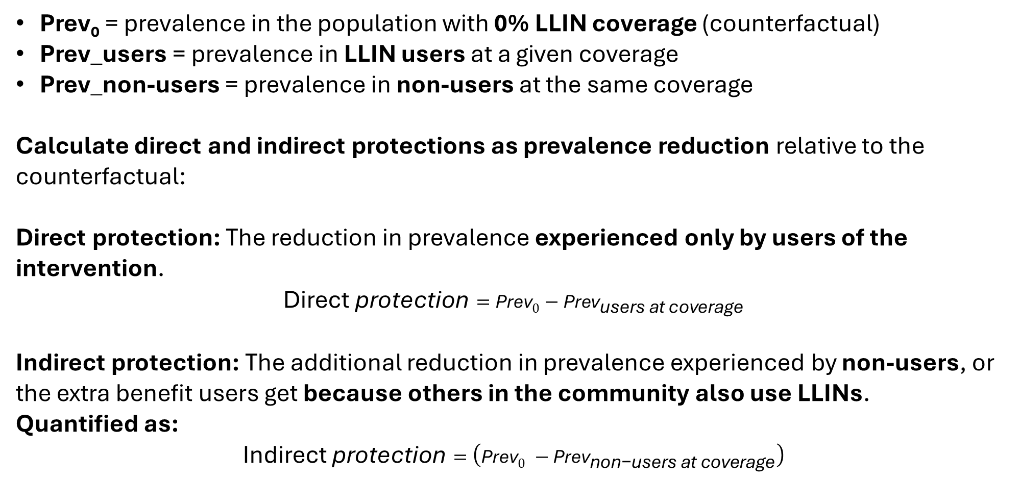
Approach
Prev₀ = prevalence in the population with 0% LLIN coverage (counterfactual)
Prev_users = prevalence in LLIN users at a given coverage
Prev_non-users = prevalence in non-users at the same coverage
Calculate direct and indirect protections as prevalence reduction relative to the counterfactual:
Direct protection: The reduction in prevalence experienced only by users of the intervention.
$$\text{Direct} \text{protection}={\text{Prev}}_{0}−{\text{Prev}}_{\text{users} \text{at} \text{coverage}}$$
Indirect protection: The additional reduction in prevalence experienced by non-users, or the extra benefit users get because others in the community also use LLINs.
Quantified as:
$$\text{Indirect} \text{protection}=\left({\text{Prev}}_{0} −{\text{Prev}}_{\text{non}\text{−}\text{users} \text{at} \text{coverage}}\right)$$

Slide 5
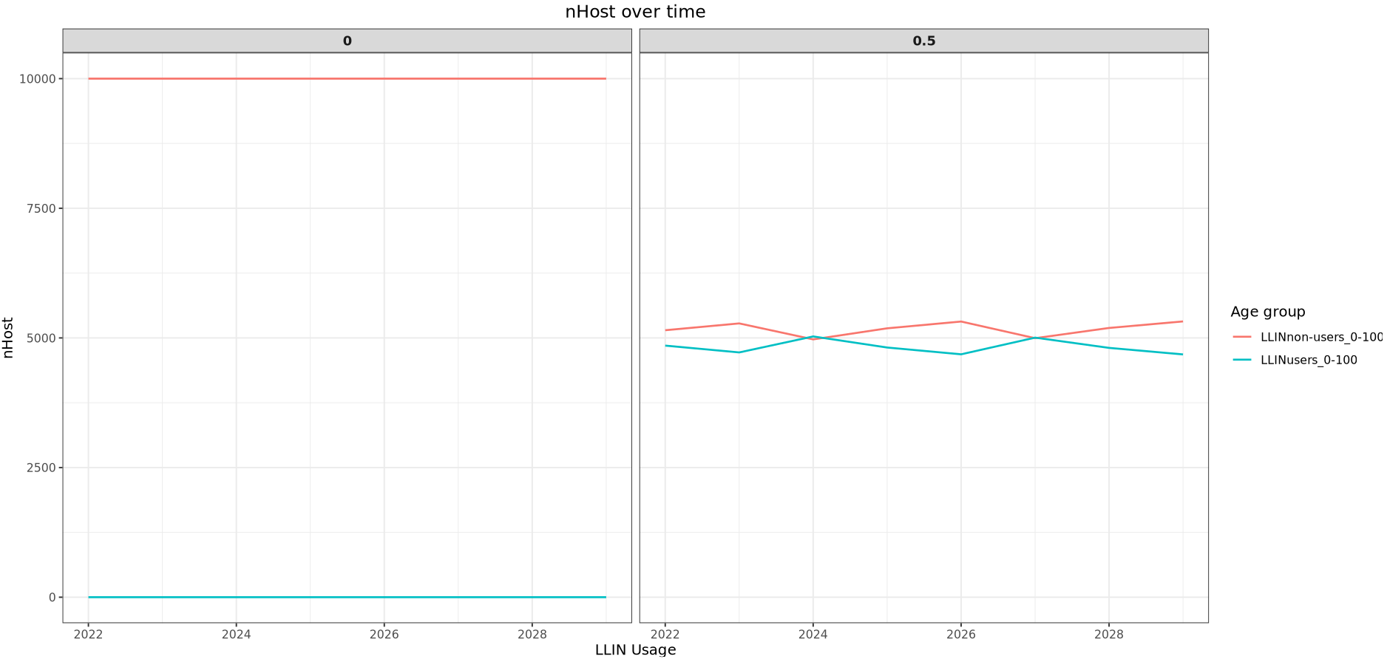
Results: Plot of nHost over time at different usage levels (EIR=60)
Notes:
Waves are showing LLIN deployments and cohort removal

Slide 6
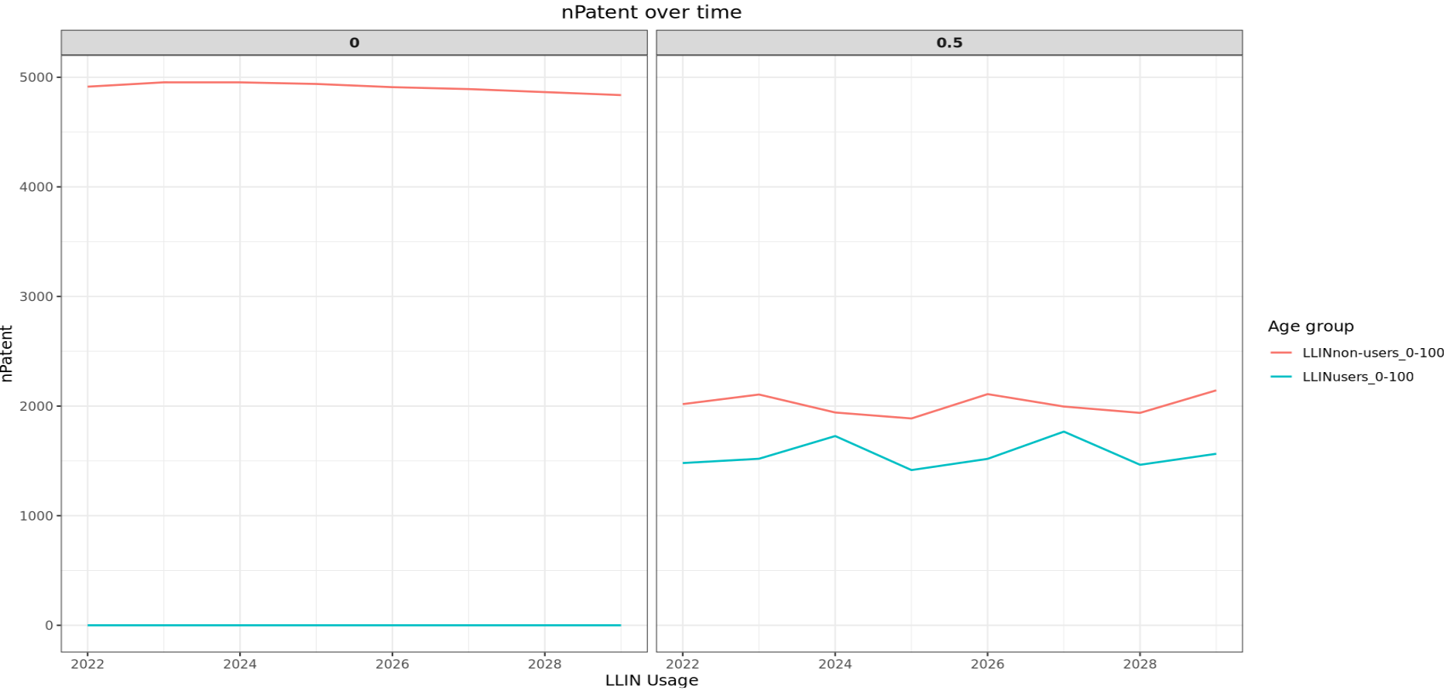
Results: Plot of nPatent over time at different usage levels (EIR=60)

Slide 7
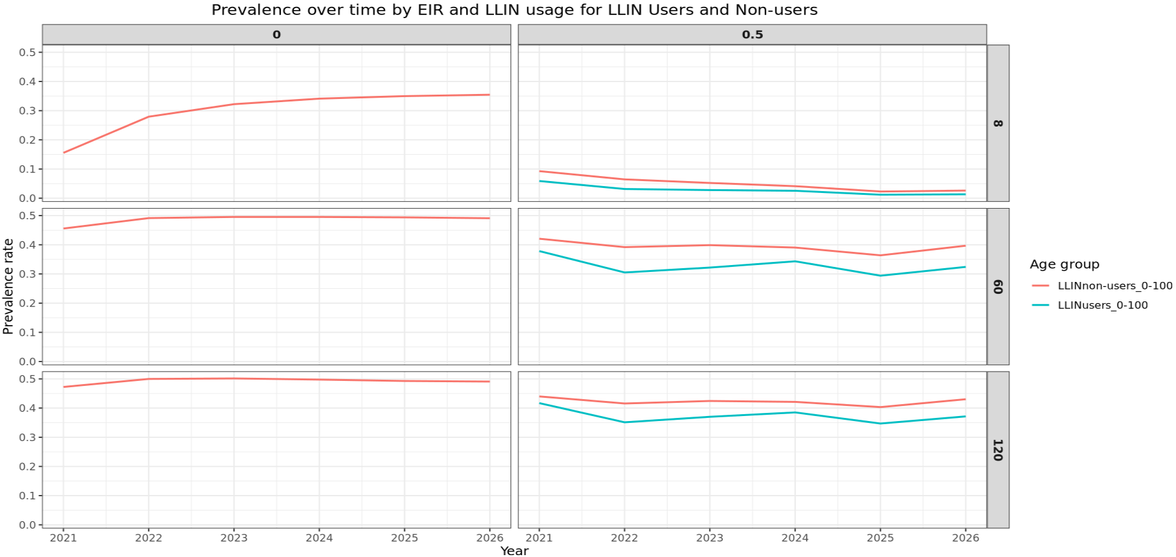
Results: Plot of prevalence over time by usage and EIR levels

Slide 8
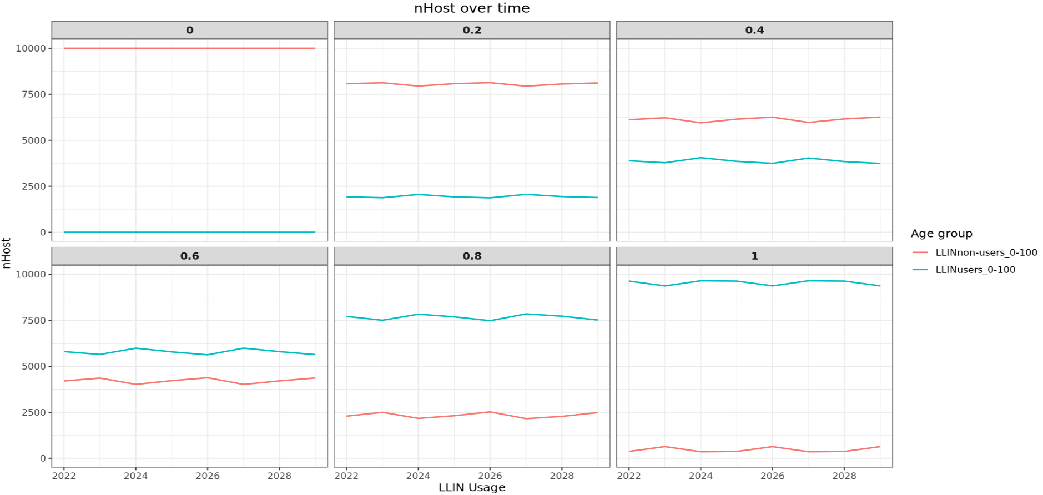
Results: Plot of nHost over time at different usage levels (EIR=60)

Slide 9
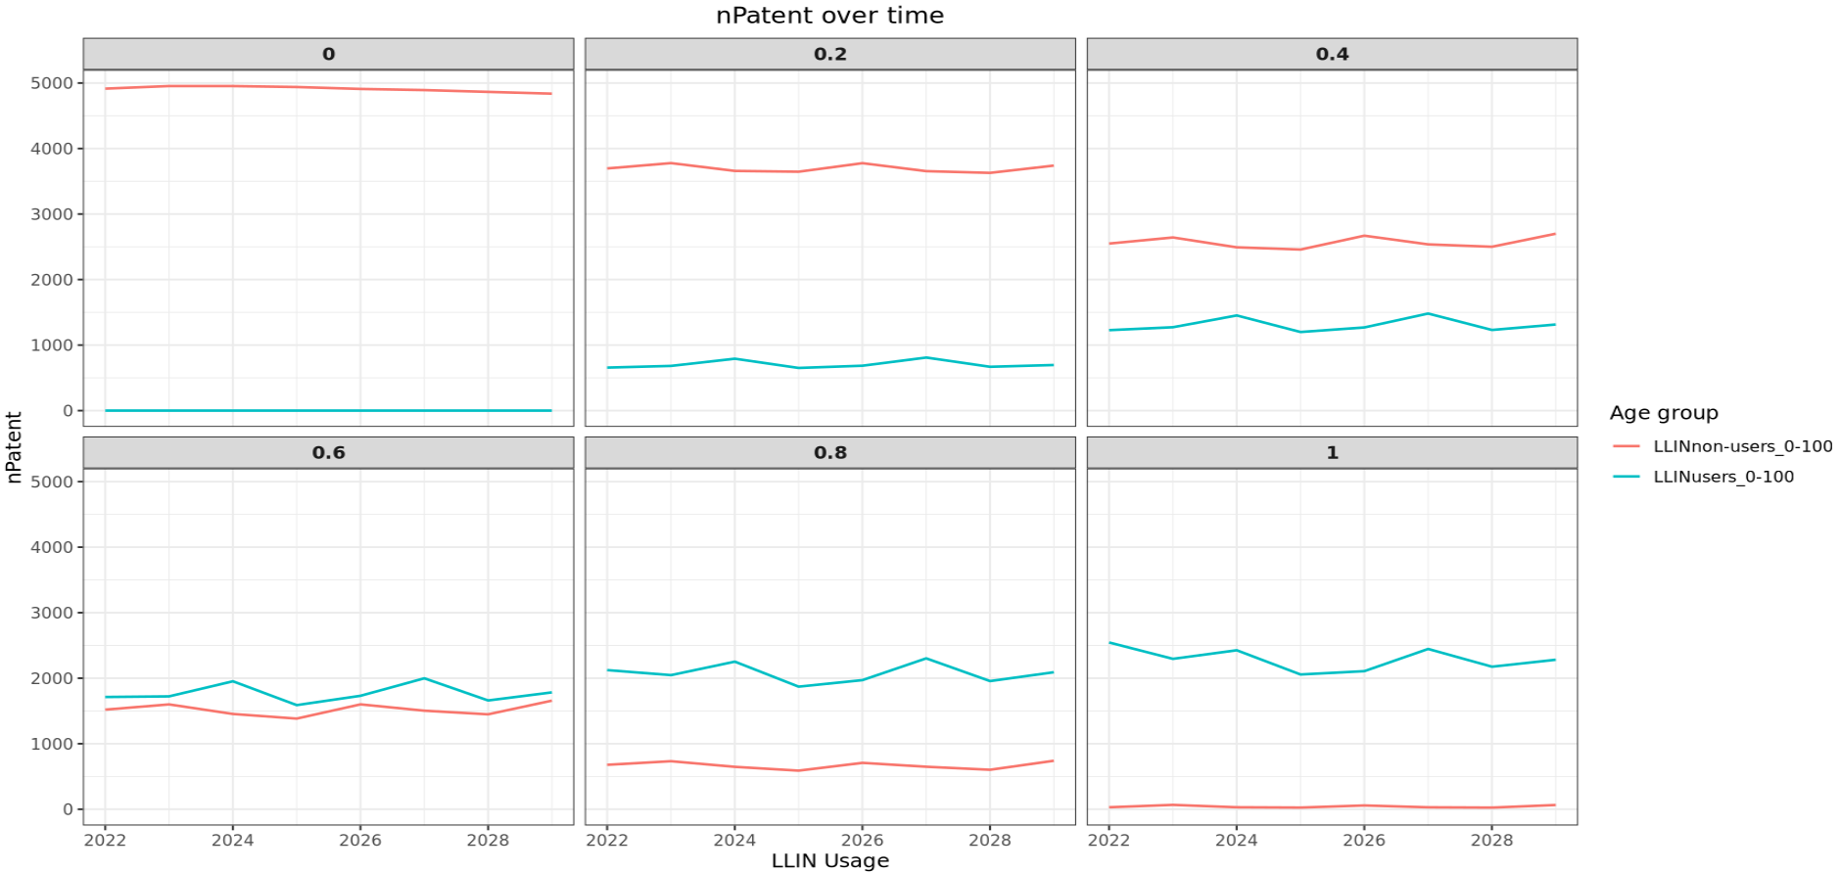
Results: Plot of nPatent over time at different usage levels (EIR=60)

Slide 10
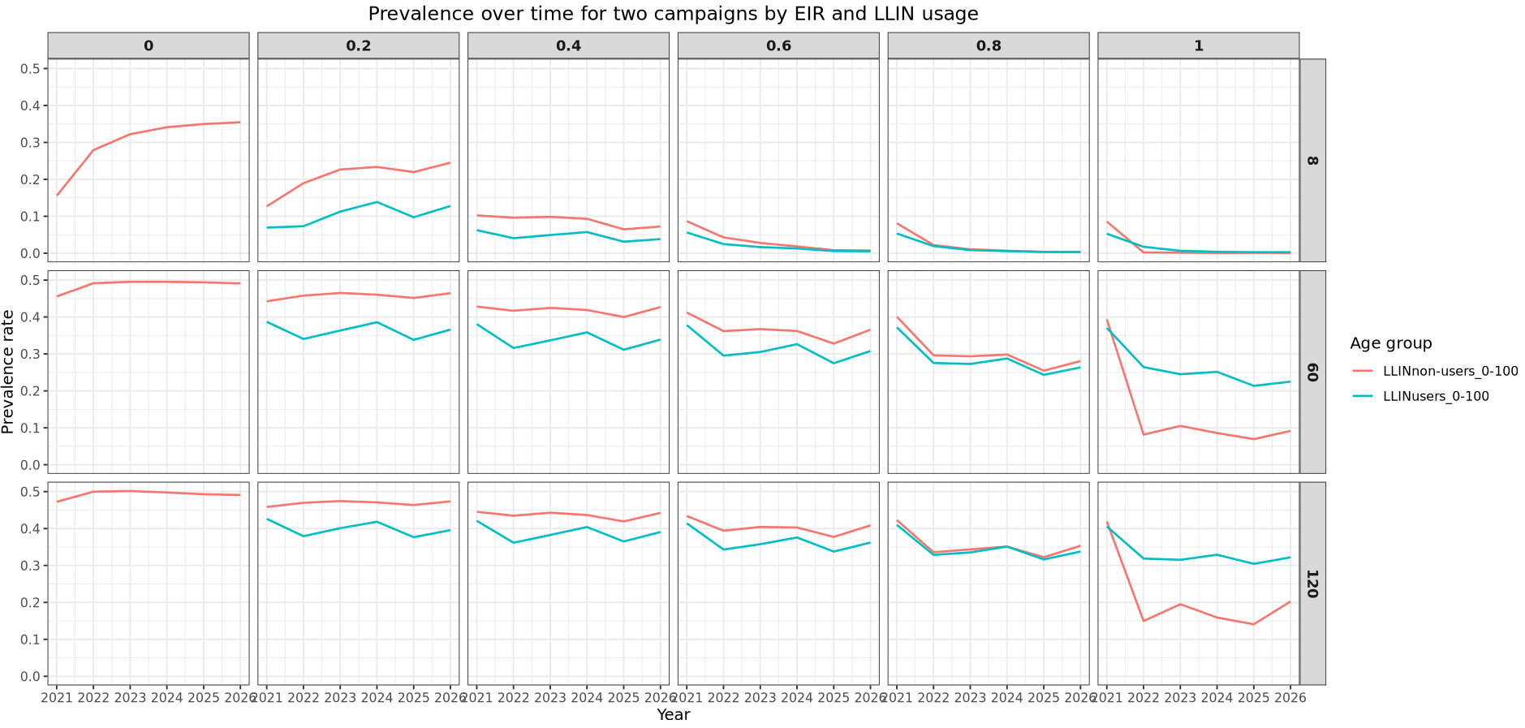
Results: plot of malaria prevalence in users and non-users by usage and EIR
Notes:
Showing prevalence over time after LLIN deployments
In high transmission settings, there is still prevalence in non-users at 100%usage

Slide 11
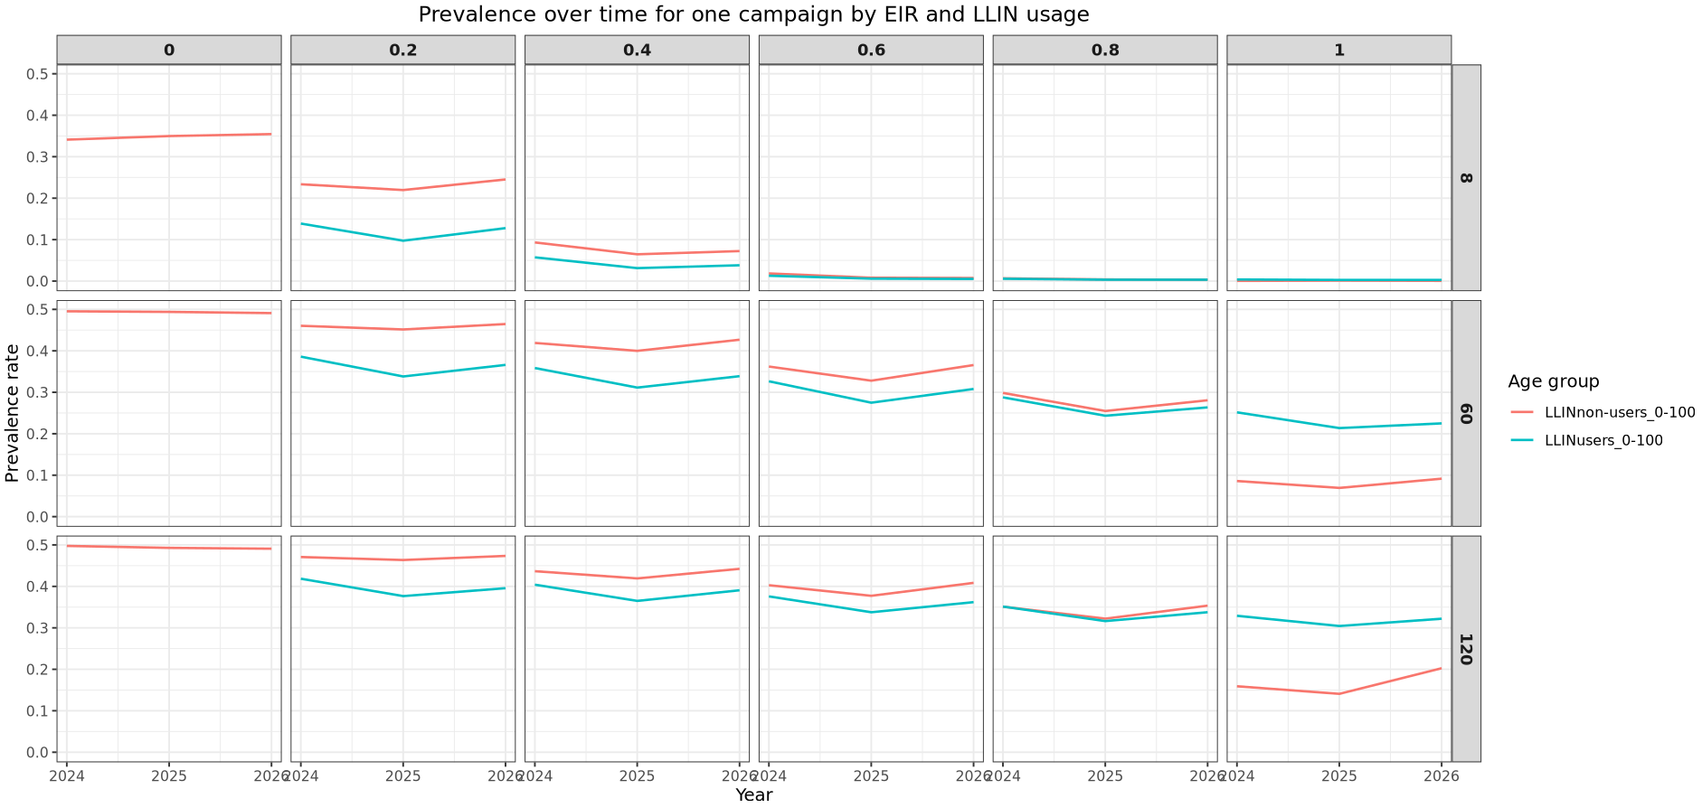
Results: one campaign

Slide 12
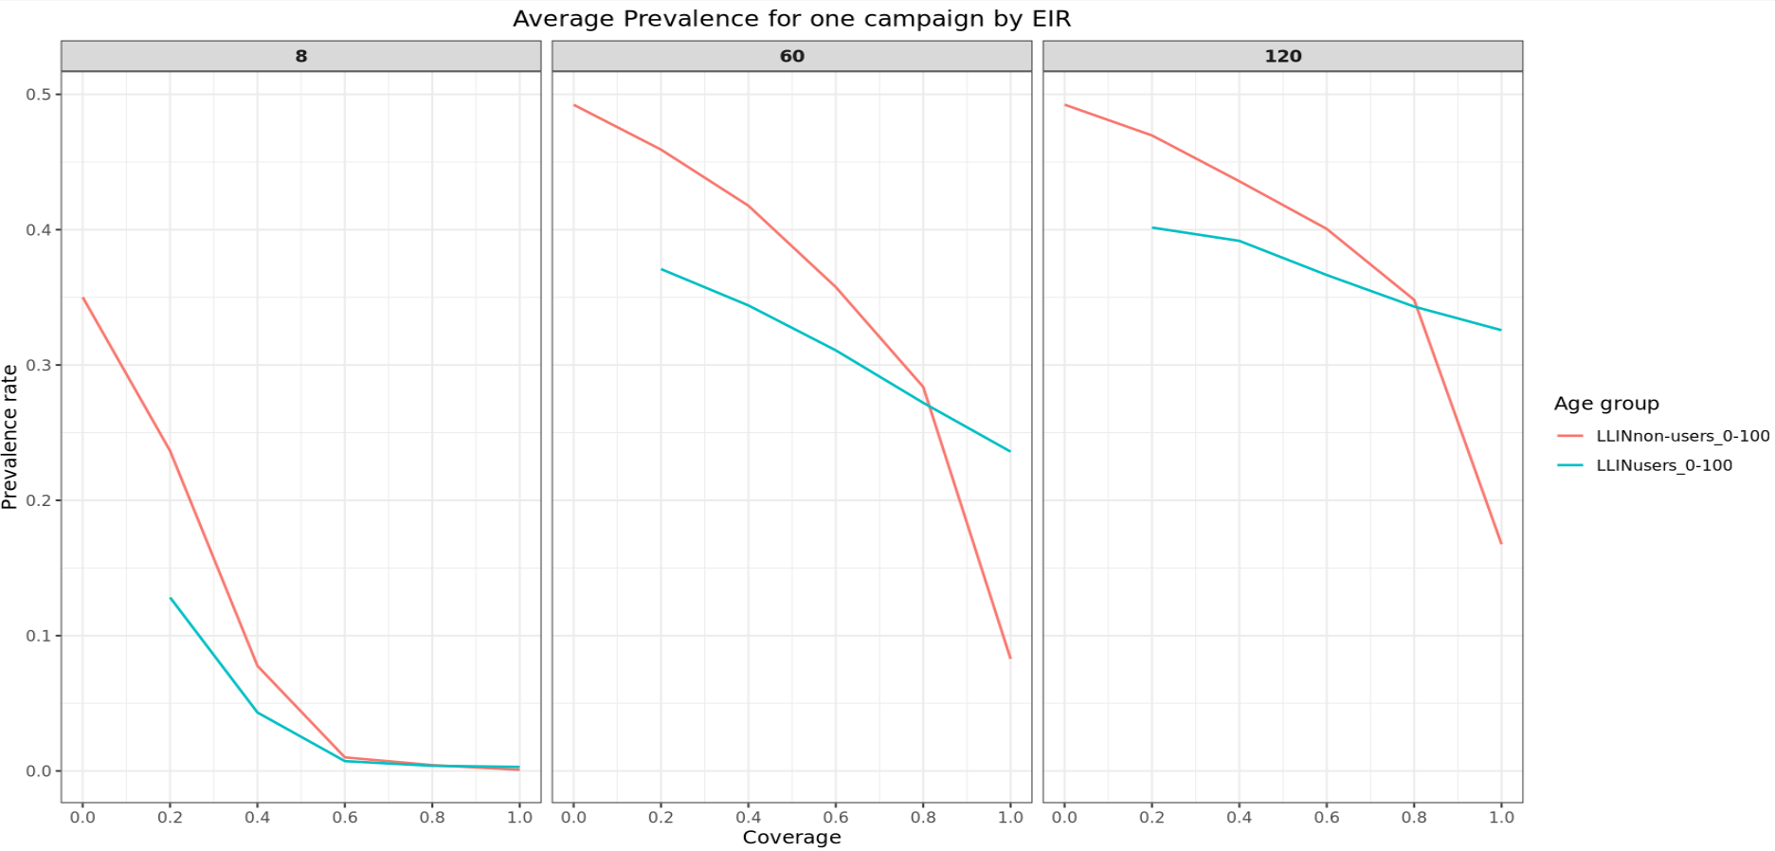
Results: average prevalence rate over the course of a single campaign
Notes:
There is still prevalence rate in non-users at 100% usage because nPatent and nHost are not entirely 0 at 100% usage

Slide 13
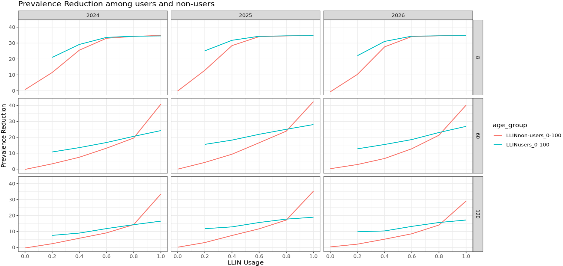
Results

Slide 14
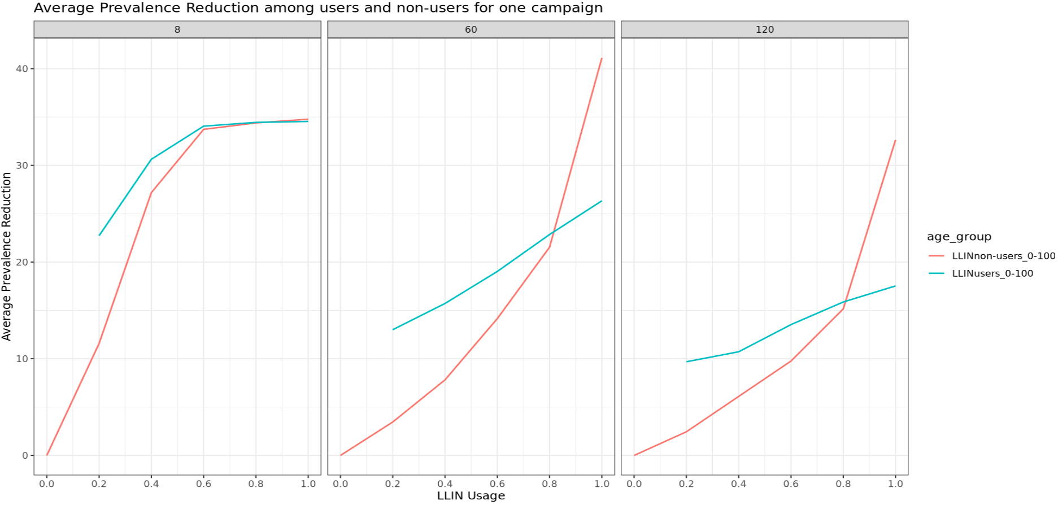
Results

Slide 15
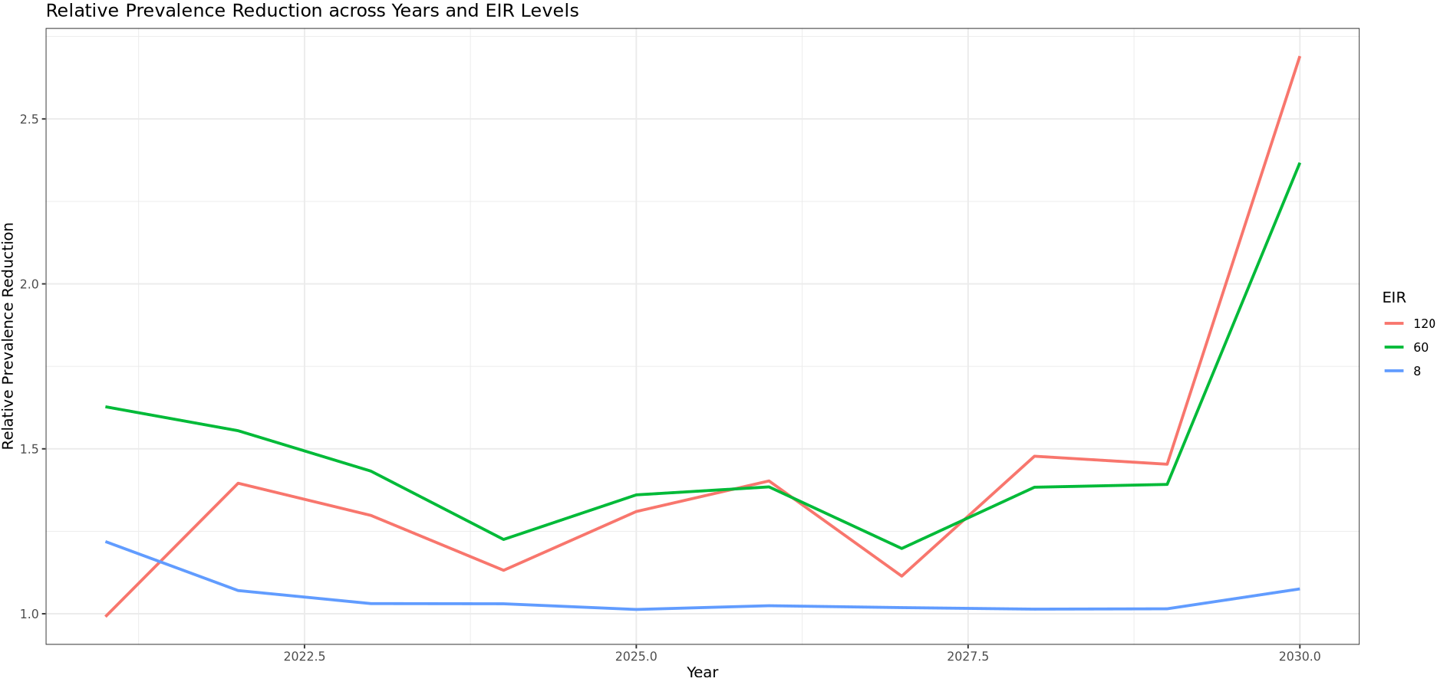
Results

